Slide 1
Teach Usa TITLE
Global Talent Development Programs

Slide 2
AGENDA
Intro to Cultural Vistas
BridgeUSA Program
J-1 Teacher Program
Application Process
Costs
School Placements
Q&A

Slide 3
Cultural Vistas leverages the power of international exchange to connect lives, enhance global skills, & drive positive change.
WHO WE ARE: OUR MISSION

Slide 4
A world full of curious, culturally competent, and globally engaged people and institutions.
WHO WE ARE: OUR VISION

Slide 5
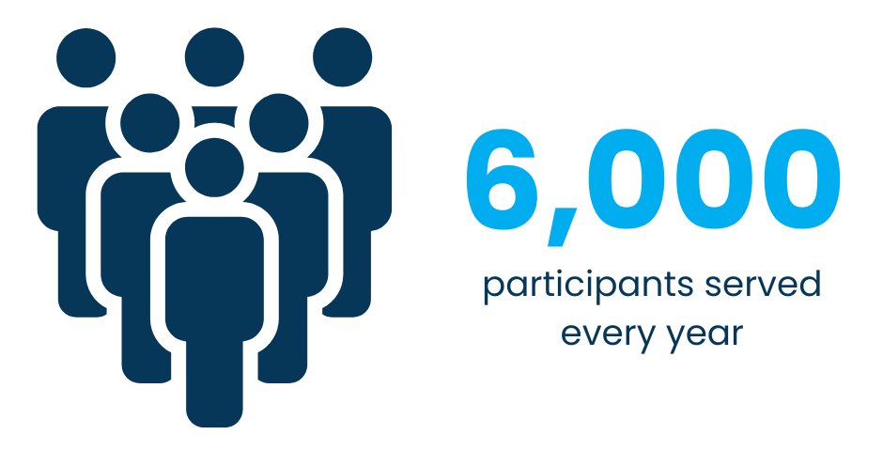
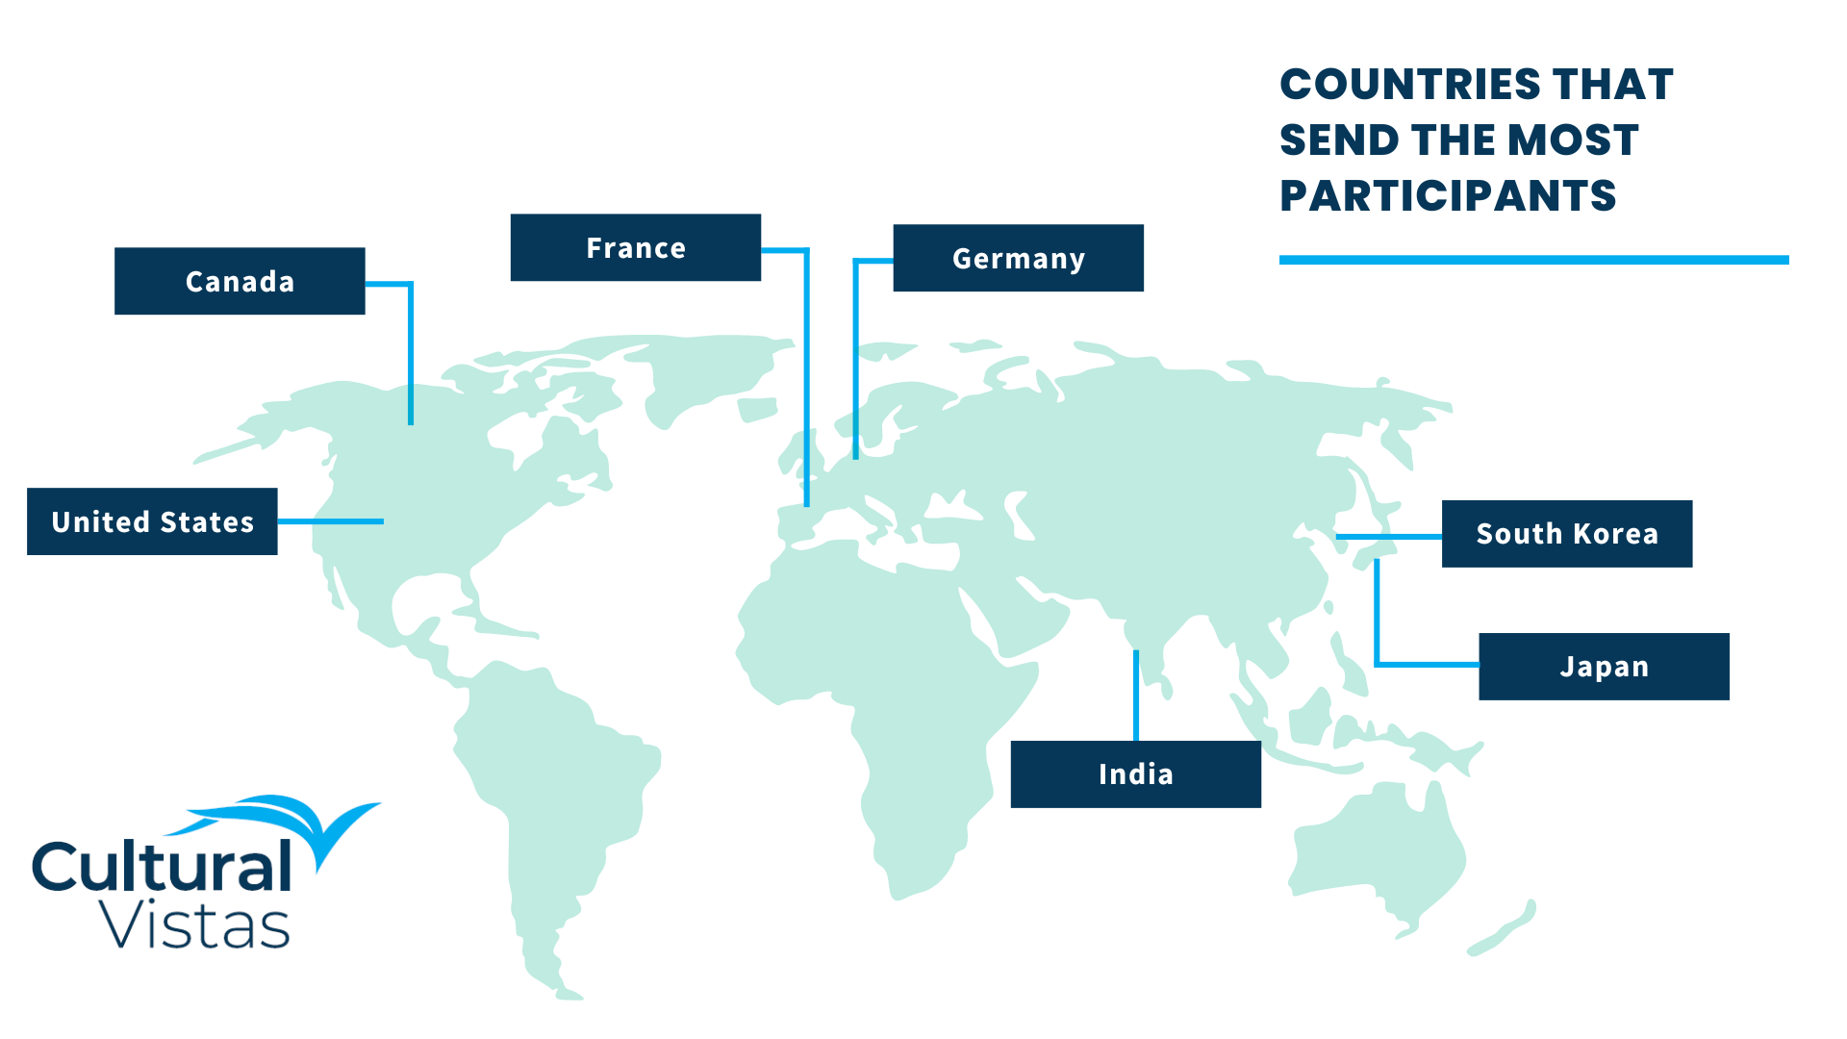
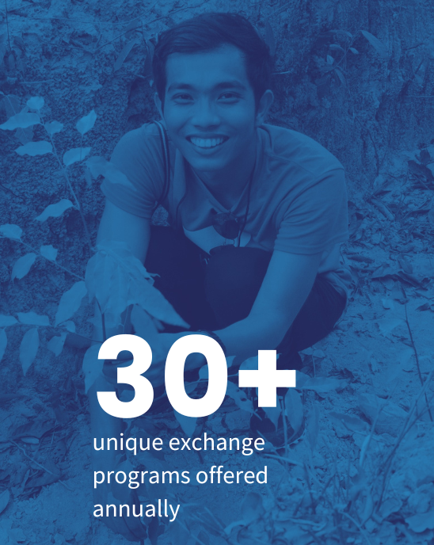
We Are Cultural Vistas
Notes:
Cultural Vistas has a long history conducting exchange programs for Americans to experience work-based learning overseas as well as for foreign nationals to experience the American workplace and gain global skills through our programs. Our programs take many shapes and can range from a couple of weeks to 5 years whether through internships, fellowships, U.S. government grant programs or meetings and workshops.

Slide 6
bridge USA
Purpose: “to increase mutual understanding between the people of the United States and the people of other countries by means of educational and cultural exchanges.”
Notes:
The U.S. government designs these programs to increase people-to-people engagement and interactions as a key part of our country’s public diplomacy with other nations. Everyone who comes on a BridgeUSA program has to apply for the J-1 Visa in order to enter the U.S. and participate.

Slide 7
BridgeUSA Program
U.S. Department of State,
Bureau of Education and Cultural Affairs
300,000 visitors annually
Public and privately funded
Non-immigrant visa (J-1)
10+ different types of programs to teach, study, research and intern
Notes:
The BridgeUSA program is created by the U.S. government and administered by the U.S. Department of State which is responsible for foreign policy and public diplomacy similar to Ministry of Foreign Affairs. The J-1 Teacher program is just one of many opportunities for cultural exchange in the U.S.

Slide 8
How does it work?
DOS Schools Americans
Oversees Host Engage
Sponsors (CV) You You
Connect Teach Learn
Notes:
Let’s review how the various stakeholders work together to facilitate BridgeUSA programs under the J-1 Visa. The role of the Department of State is to create the program structure and visa rules and oversee the private organizations like Cultural Vistas who manage the day-to-day directly with schools and teachers. Our role is to connect with teachers and schools and support you throughout the application process and during the program. We will determine if you are qualified for the program and provide you the ability to request a J-1 visa from the U.S. government. We do not grant the visa. We also will monitor the program, provide resources and work to create a successful experience. The schools will offer you a position teaching in their school and also assist you in transitioning to a new education system and offering guidance and professional development. Your job is not only to teach but to learn! You will be able to learn about American education systems and practices, get to know American youth as well as parents and colleagues and get out into the community to learn regional and local culture and history.

Slide 9
What are Sponsors?
U.S. Department of State authorizes independent organizations to sponsor J-1 Visa participants.
Sponsoring organizations issue the Certificate of Eligibility form (DS-2019) which allows the participant to apply for the J-1 visa.
Sponsors implement federal regulations and monitor programs protecting the health, safety and welfare of participants throughout program.

Slide 10
Sponsor Role
Screen teachers/schools/positions for eligibility
Facilitate securing the visa
Provide in-country support and orientation
Maintain visa records in SEVIS
Report to Department of State
Notes:
Note: We cannot guarantee you will be approved for the visa. This decision rests solely with the U.S. government. In our experience, it is rare for a teacher to be denied the visa.

Slide 11
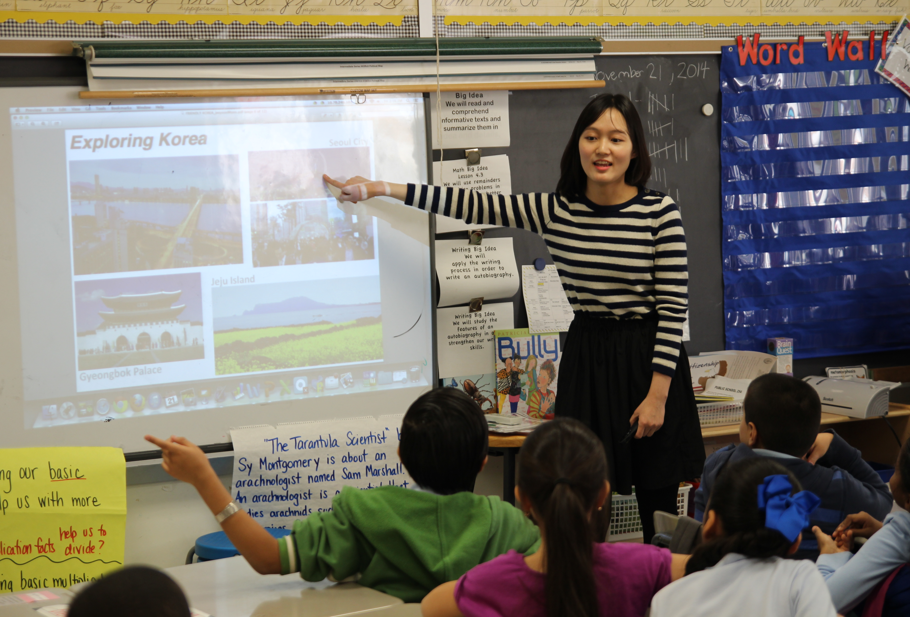
J-1 Teacher Program
Content/Text
Content/Text

Slide 12
J-1 Teacher Programs
Designed to provide opportunities for international educators to live in the U.S.; teach in American schools and create cross-cultural learning;
Teachers better understand U.S. culture, society and teaching practices at the primary and secondary levels (K-12);
Enhance U.S. students' knowledge of foreign cultures, customs and teaching approaches;
Participants return home upon completion of program
Notes:
This specific program is only for K-12 educators for positions in K-12 schools with one exception for pre-K language immersion positions.

Slide 13
School Placement
J-1 Visa
J-1 Teacher Program Participant
Sponsorship Approval
Notes:
Before you can apply formally for J-1 Visa sponsorship with Cultural Vistas or apply for the visa at the U.S. Embassy, you must secure a job offer from a school. With an offer, you can apply for sponsorship and then, if approved, you apply for the visa itself so that can be admitted to the U.S. under the J-1 Visa.
Note: Canadian citizens do not have to attend an in-person visa interview at a U.S. Embassy or Consulate. Thus, they do not receive a physical visa in the passport but will be processed at the border by U.S. Customs and Border Protection under the J-1 classification.

Slide 14
Positions
A J-1 Teacher:
Meets the Teacher category requirements
Role is an employee of the school
Is teacher of record: carries official responsibility for education of the class, assigning grades and providing feedback and lesson planning.
Must be licensed and qualified in accordance with state law where applicable
Not an administrative or non-instructional position (vice-principal, guidance counselor, etc.)
Not a classroom assistant or aide

Slide 15
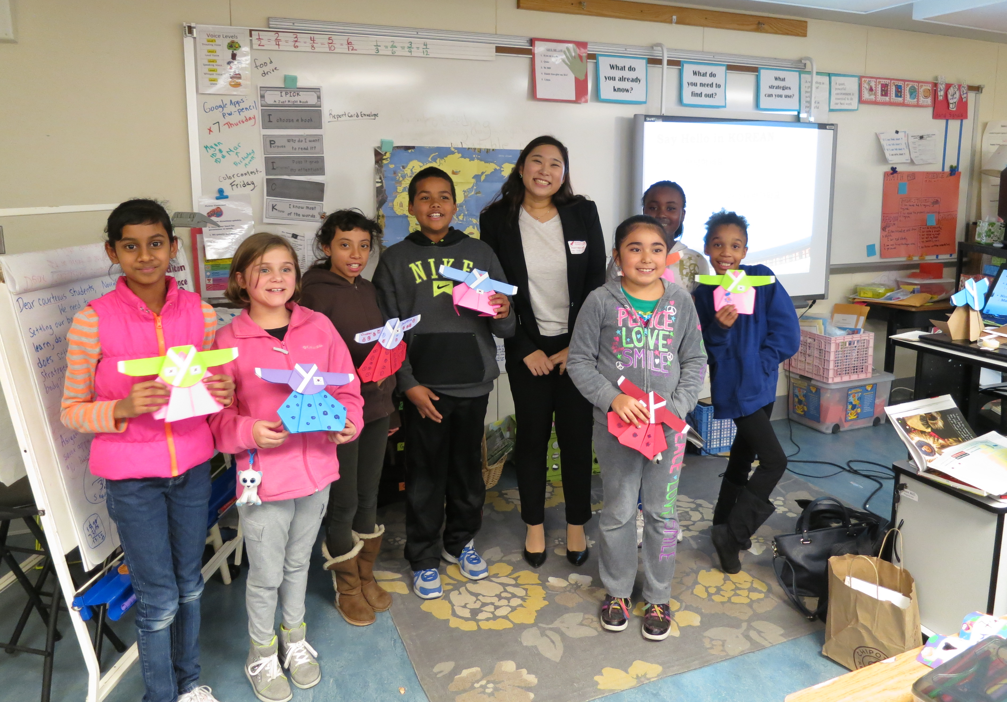
Intercultural
Learning
Component
Intercultural Learning
EXCHANGE VISITOR PROGRAM
Two types each year
Share history, traditions, heritage, culture, economy, educational system.
Connect foreign students and American students through virtual exchange or other means.
Report annually to CV
Notes:
This component is at the heart of the program and Cultural Vistas’s goals. We know that every day your students will be learning a little bit more about you and your background and you will be absorbing and experience American life. These interactions help you and your students build intercultural skills to navigate the wider world including how to communicate across cultures, appreciate varied perspectives and create understanding and collaboration between people. Part of your visa requirement will be to create two intercultural learning activities each year. You will report these to us annually to remain in good standing with the program and be eligible to extend. Sharing your culture is required as well as connecting American students and overseas students directly.

Slide 16
EXCHANGE VISITOR PROGRAM
Program Components
Placement with host school and full-time position starting Aug-Sept 2023
J-1 Visa sponsorship to teach in the United States for up to 5 years*
24-hour emergency support for participants and host schools
J-2 Visa sponsorship for spouse and/or children under 21 to join the J-1 teacher
Medical insurance
Orientation and cultural training
Networking and professional development opportunities in select cities
Access to free tax software for teachers for non-residents
*your initial program period will be no more than 3 years with options to extend
Notes:
These are the benefits and services we will provide for your program.
We recommend that spouses and children join the teacher in the second semester or year to allow you time to focus on your transition into your school and job duties.
We do not provide housing or transportation in the U.S.

Slide 17
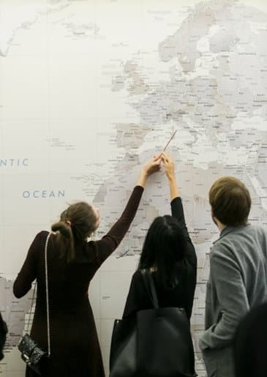
EXCHANGE VISITOR PROGRAM
Is this for me?
BridgeUSA IS for participants to:
gain new knowledge and skills in their profession
be immersed in American culture
be cultural ambassadors for their home country
share what they’ve learned with their home communities
BridgeUSA IS NOT for participants who:
seek permanent status in the U.S.
are not open-minded, flexible and adaptive
Notes:
The J-1 visa is classified as non-immigrant and meant to be a temporary stay in the U.S. For the Department of State to meet the public diplomacy goals for the program, exchange visitors return home after the program to share what they’ve learned with their friends, family and colleagues. The consular officer will be evaluating your intent during your visa interview and will use this in making a decision on whether to grant the visa. Similarly, Cultural Vistas will be using this to evaluate applications for the program.

Slide 18
Eligibility requirements
Teacher | Schools and Positions
Equivalent of U.S. Bachelor degree in education or the subject you will teach | Public or private schools
2 years of full-time teaching experience in K-12 schools | K-12 positions and pre-K language immersion positions
Meets teacher qualifications in your country | Full-time minimum 32 hours per week as teacher of record
Advanced English proficiency | Temporary appointment
Is of good reputation and character | Follows academic year (Aug-June)
Meets standards of state where assigned | Compensation matches American teachers
Currently teaching in K-12 schools at the time of application to sponsor*
Notes:
Please review the eligibility requirements for the program.
*There is one exception to those who are not currently teaching at the time of application. Those who are pursuing an advanced degree in education or the subject they plan to teach or have received such a degree within the 12 months prior may qualify if they meet all other qualifications.
Licensing: If you are placed with a public school, you will need to follow the state requirements for becoming a teacher which may include a license, subject knowledge test, and/or background check. These will carry some additional cost. Each state is different in terms of application timelines and deadlines to meet these requirements.
You do not have to work during the official summer break unless requested and agreed to in your contract and by Cultural Vistas. You may travel or return home during the summer.

Slide 19
Application process

Slide 20
Timeline + Process
Continuous January-May | Interested applicants submit resumes and are screened by CV. Cultural Vistas introduces teachers to prospective host schools and teachers are interviewed by schools. Upon receipt of offer, teacher applies for visa sponsorship from Cultural Vistas. Fees are due at this time.
June | Approved teachers receive DS-2019 Certificate of Eligibility, proof of visa sponsorship.
July | Teacher schedules in-person visa interviews or proceeds to the U.S.**
August- September | Teachers arrive at host schools for new teacher orientations.
Notes:
The above timeline is approximate. The placement process will be on-going and each person may proceed on a different timeline.
Note: Canadian citizens do not have to attend an in-person visa interview at a U.S. Embassy or Consulate. Thus, they do not receive a physical visa in the passport but will be processed at the border by U.S. Customs and Border Protection.

Slide 21
EXCHANGE VISITOR PROGRAM
Teacher Application Process
Resume, Credential Evaluation Report and one reference- required to be considered for placement
Upon receiving an offer:
Online applications
Documentation of experience (diplomas, references)
English interview with Cultural Vistas
Cultural Activity ideas
Budget
Dependent information (recommend J2s join later)
Notes:
To be considered for placements, you must provide a credential evaluation report, one reference and your resume. A credential evaluation is something you purchase from an expert agency in comparing your education to standard higher education programs in the U.S. such as bachelor, master and PhD. This will cost at least $85.
If you are selected for a teaching position, you will complete an online application form as well as several documents to confirm your education and work experience and various information we need to determine if you are qualified and ready for the program. With this complete application, we will decide if we can formally offer you sponsorship.
J2s can apply for a work permit after they arrive which may take a few months. This process does not involve Cultural Vistas.

Slide 22
Cultural Vistas Fees
Year 1 |  |  |  |  | Additional
One Year | $1,750 | $1,750 |  |  | One-year extension | $950
 |  | $500 |  |  | Two-year extension | $1,900
SEVIS Fee | $220 | $220 |  |  | Year 4 and 5* | $1,950
CV Health Insurance* | $60 -$120/mo. | $48 or $88/mo. |  |  | *(DOS approval required)
Dependent fee (if applicable) $750 *insurance through our partner for J2 coverage may be higher
U.S. Teacher Salaries
National Education Association:
Average starting teacher salaries in each state for 2017-18: $31,000 - $55,000
National average public school teacher salary for 2017-18 was $60,477
Notes:
There will be some schools who are able to assist with covering the cost of visa sponsorship. For the purposes of your budget, you should plan to cover the entire cost. Please note the Year 1 column on the left. These are the fees that would be due prior to approval by CV. The right column includes fees related to extending your program beyond the initial period.
Whether you are offered a one or two year contract initially, you may apply for an extension at the end of the school year if your contract is renewed. Conversely, you may be offered a full 3 year contract initially depending on the school. Most schools cannot offer more than one year at a time contractually. At the end of year 3, if you and the school would like to extend up to 5 years, there is a special request process which involves the Department of State making this decision and not Cultural Vistas.
You will be required to take CV insurance or an option we choose in order to meet J1 visa requirements for at least the first year. You may enroll as an employee in your school’s insurance in addition if you wish after you get here. We can consider substituting this after year 1 if it can be verified that it meets J1 requirements. Many school policies do not.
Salaries for teaching positions vary widely throughout the country as does the cost of living. The averages above do not include deductions for state and federal taxes, medical insurance or other benefits or adjustments of cost of living and represent an average from teachers with decades of experience and well as very little.

Slide 23
Program Cost
Evaluating whether you have the funds to participate is a critical first step in this process. We understand you can’t know all the exact details right now and much will depend on how much your school can cover.
Read through our article on budgeting.
Download this estimate of pre-departure and arrival costs.
Notes:
There will be some schools who are able to assist with covering the cost of visa sponsorship. For the purposes of your budget, you should plan to cover the entire cost. Please note the Year 1 column on the left. These are the fees that would be due prior to approval by CV. The right column includes fees related to extending your program beyond the initial period.
Whether you are offered a one or two year contract initially, you may apply for an extension at the end of the school year if your contract is renewed. Conversely, you may be offered a full 3 year contract initially depending on the school. Most schools cannot offer more than one year at a time contractually. At the end of year 3, if you and the school would like to extend up to 5 years, there is a special request process which involves the Department of State making this decision and not Cultural Vistas.
You will be required to take CV insurance or an option we choose in order to meet J1 visa requirements for at least the first year. You may enroll as an employee in your school’s insurance in addition if you wish after you get here. We can consider substituting this after year 1 if it can be verified that it meets J1 requirements. Many school policies do not.
Salaries for teaching positions vary widely throughout the country as does the cost of living. The averages above do not include deductions for state and federal taxes, medical insurance or other benefits or adjustments of cost of living and represent an average from teachers with decades of experience and well as very little.

Slide 24
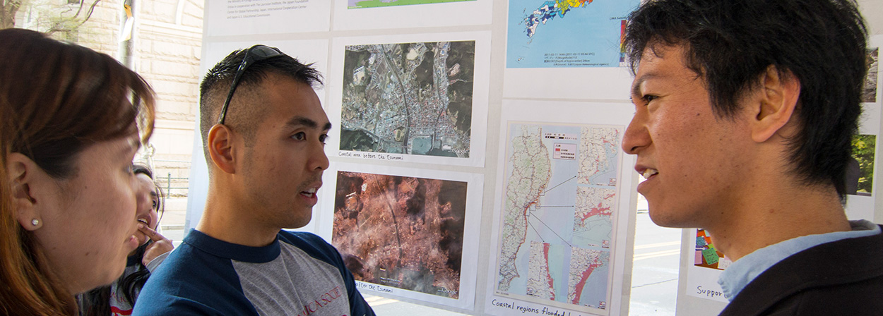
heading
ENGLISH REQUIREMENTS

Slide 25
EXCHANGE VISITOR PROGRAM
English Requirements
J-1 rules require you to have sufficient English to participate in the program, pursue your approved activities and interact with Americans.
Cultural Vistas will conduct an interview with each applicant and make an assessment.
Language ability will factor into school hiring decisions.
Notes:
During the application process, we will conduct a phone interview with you to make an assessment. The schools will also conduct interviews with you in English and it will be an important part of their decision making.

Slide 26
School Placements

Slide 27
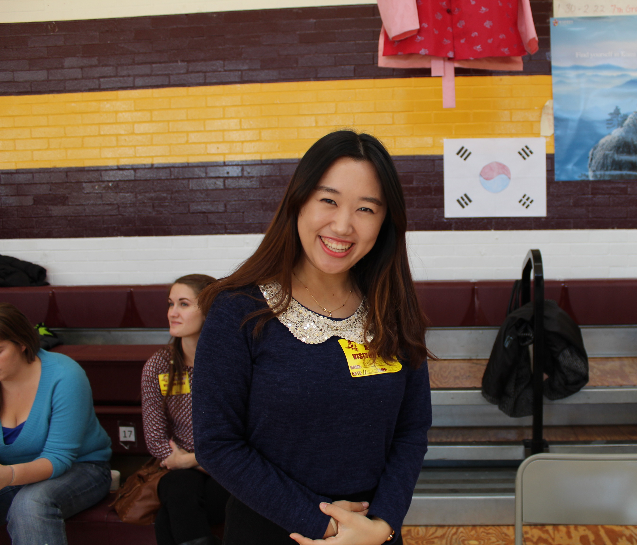
PLACEMENTS
Why They Want You!
Diversify teaching staff and perspectives
Bring the world to U.S. classrooms and communities
Add to existing talent pipeline for hard to fill positions
Create opportunity for students to interact with students from your country
Host native language speakers for language programs
Establish linkages with schools abroad for future exchange
Notes:
You may be wondering why U.S. schools would want to hire foreign teachers. Interest in hosting international educators varies from wanting a diverse perspective in the classroom and for their students, to enriching their language courses, to establishing long-term exchange relationships with overseas schools. Last year more than 4,000 new teachers headed to the U.S. to start teaching.

Slide 28
PLACEMENTS
Placement Expectations + Process
We cannot guarantee you offers in specific locations or specific salaries. You should only submit your resume if you are pretty flexible about where to go.
If a school is interested in your resume, you would be interviewed and have the opportunity to consider whether any position is right for you. Resumes will be shared with schools though in some cases we may direct you to apply through the school’s online application process.
The exact start date of the program is dictated by the start date of your school and reporting dates for teachers.
The exact length of your initial program term is mostly dictated by budget. A 3-year program requires the 3-year fee up front. Remember, you can start with one year and renew annually up to 5 years.

Slide 29
Next steps
You are invited to submit an application of interest for initial evaluation. Those who pass initial screening will be considered for placements and your resume will be shared with schools. If you receive a job offer, you will be asked to complete our full application for sponsorship in order to obtain the visa and verify your qualifications (diplomas, references, etc.). We do not guarantee you a position and only those who fit our positions will be contacted.
If you’re interested but would rather pursue opportunities on your own, start searching! If you secure a position from a school, we can still consider you for visa sponsorship. Please do not accept any offers until you speak with us. Our spaces are limited each year so we cannot guarantee that we will be able to sponsor you in this case.
Notes:
You can also consider applying on your own for teaching jobs. Most schools publish these positions online. They may or may not be familiar with the J-1 program but you can apply directly and discuss this option with them. They do not need to be pre-approved or registered with us in advance. If you do secure a contract, you and the school can submit an application to us for consideration.

Slide 30
Thank you
www.culturalvistas.org

